Slide 1

Find the Influential Node of a Dynamic Graph
Ranojoy Barua (510515025)
Ankita Choudhary (510515058)
Rounak Mazumder (510515014)
Aniket Sarkar (5105150__)
Guided by : Prof. Susanta Chakraborty

Slide 2
Motivation
Due to urbanization huge number of cities are coming up with a large road network.
Represent the total road network on graph.
Find the most influential road in a given city (graph) for smooth movement of traffic in the whole city.

Slide 3
Introduction
Difficult to analyze large graph.
Road are interlinked and this makes the whole network a complex structure.
Each place is represented as nodes
Each road is represented as edges.
The influential node of the whole network represents the most important place or junction of the city or state.

Slide 4
Objective
Representing a graph in edge list.
Clustering the total road network using K-Mean algorithm.
Find most influential road in each cluster by calculating parameters:
1) Freeman’s degree centrality
2) CC value
3) Enhanced degree centrality
4) Eigen-Vector centrality

Slide 5
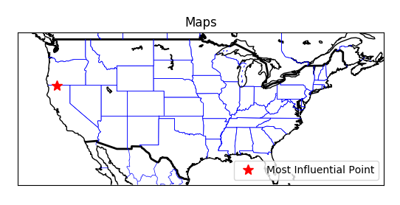
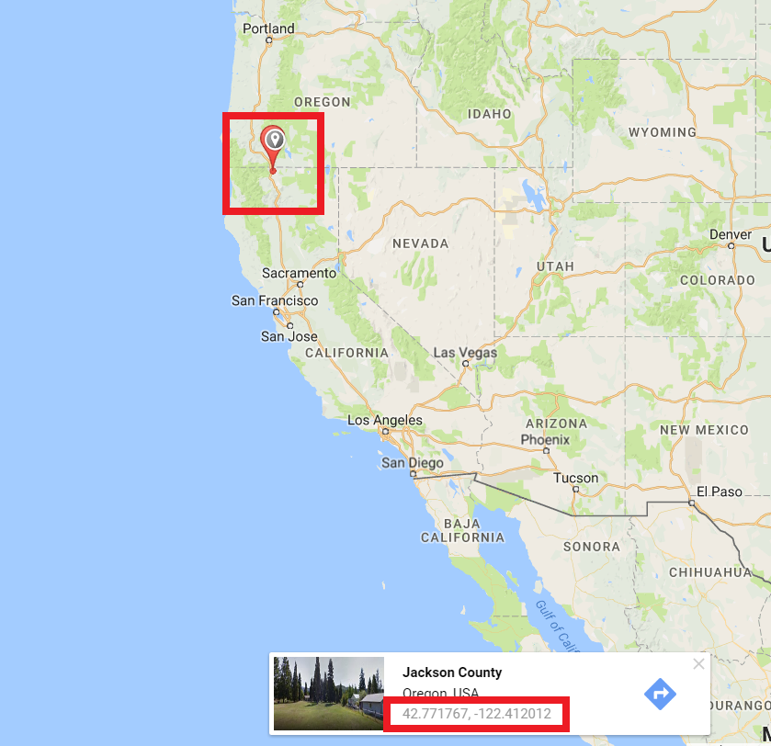
Result
Obtained result
Plot on political map of USA on Google Map
1) The most influential node is located at longitude : -122.520287
and latitude : 41.907001
2) The influential node is situated in the junction of California and Oregon.
3) If this road is availed then most places can be reached in minimum time.

Slide 6
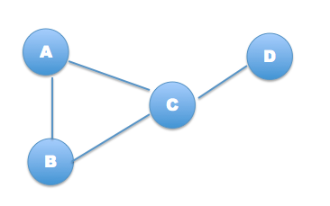
Preliminary
Representing a graphs by using edge list.
A | B | C
B | A | C
C | A | B | D
D | C

Slide 7
Method
Cluster the total road network in ‘k’ clusters.
For each cluster calculate all three above mentions parameters and sort in ascending order with respect to the each parameter independently.
Add rank of all the parameters for each node.
The node with smallest aggregate rank is most influential node.
Find the co-ordinates of the most influential node from data-set.
Plot it in map.

Slide 8
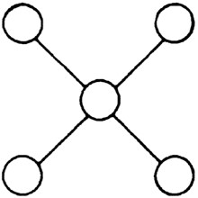
Preliminary
Influential node : Node that is well connected through out the graph.
Node in the center is
the most influential node.

Slide 9

Preliminary
K-Mean clustering : K-means clustering aim to partition n observations into k clusters in which each point belongs to the cluster with the nearest mean.

Slide 10

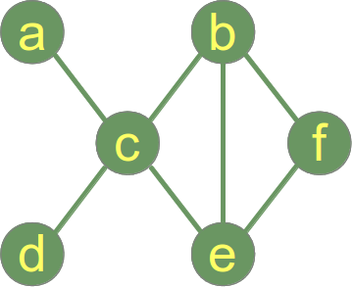
Method
1) Clustering coefficient (CC value) [1]
It is a measure of the degree to which nodes in a graph tend to cluster together.
CC(e) = 2/3
Numerator is 2 of the presence of the two edges b-c, b-f.
Denominator is 3 because all total three edges can be formed in between nodes c, b and f i.e., b-c, b-f and c-f.

Slide 11

Method
2) Freeman's degree centrality [2]
Measures the connectivity of a given node with its neighbor.
FDC(e) = 3/2
Numerator is 3 because |(4-4)| + |(4-3)| + |(4-2)| i.e., (Summation of mod of difference between the maximum degree and degree of all of the neighboring nodes).
Denominator is 2 because
|(3-4)| + |(3-3)| + |(3-2)|

Slide 12
Method
3) Enhanced degree centrality [3]
Product of CC value and Freeman's degree centrality. It measures the connectivity of the nodes connected to a given graph.
EDC(e) = CC(e) * FDC(e)
EDC(e) = (2/3)*(3/2)
EDC(e) = 1

Slide 13
Method
4) Eigenvector Centrality [4]
Eigenvector centrality is the measure of influence of a node in a network.
It assigns relative score to all nodes in the network based on the concept that connection to high scoring nodes contribute more to the score of the node in question than equal to low scoring nodes.
It is determined by performing a matrix calculation to determine what is called, the principal eigenvector using the adjacency matrix.

Slide 14
Method
Eigenvector Centrality :
C
F
G
E
A
X
Z
Y
B
Degree:4
Eigenvect centrality:0.091
D
Q
R
P
Degree:3
Eigenvectorcentrality:0.182

Slide 15
Method
K-Mean clustering : K-means clustering aim to partition n observations into k clusters in which each point belongs to the cluster with the nearest mean.
Algorithm :
a) Select randomly K-points.
b) For all points calculate distance (Euclidian) distance of each point with K centers and assign to the cluster with minimum distance.
c) Recalculate the centers of all clusters by taking average of each vectors.
d) Redo step b and c till the members of clusters keeps changing.

Slide 16
Method
Serial Number | X-axis | Y-axis
A | 1 | 2
B | 2 | 3
C | 7 | 8
D | 8 | 6
E | 9 | 10
Data points to be clustered.
Serial Number | X-axis | Y-axis
C1 | 2 | 3
C2 | 7 | 8
Randomly selected points for K = 2

Slide 17
Method
Calculation :
c1 - a) root(square(2-1) + square(3-2)) = root(1+1) = root(2)
c1 - d) root(square(2-8) + square(3-6)) = root(36+9) = root(45)
c1 - e) root(square(2-9) + square(3-10)) = root(49+49) = root(98)
c2 - a) root(square(7-1) + square(8-1)) = root(36+49) = root(85)
c2 - d) root(square(7-8) + square(8-6)) = root(1+2) = root(3)
c2 - e) root(square(7-9) + square(8-10)) = root(4+4) = root(8)
(c1 - a) < (c2 - a)
(c1 - d) > (c2 - d)
(c1 - e) > (c2 - e)
So, point (a) assigned to (c1)
and point (d) and (e) assigned to (c2)

Slide 18
Method
In iteration 1:
c1) (2,3) and (1,2)
c2) (7,8) , (8,6) and (9,10)
Now recalculate the centers:
c1) x:[(2+1)/(2)] = 1.5 y:[(3+2)/(2)] = 2.5
c2) x:[(7+8+9)/(3)] = 8 y:[(8+6+10)/(3)] = 8
Co-ordinate for center:
c1) (1.5 , 2.5)
c2) (8.0 , 8.0)

Slide 19
Method
Re-do the calculation of Euclidian distance:
c1 - a) root(square(1.5-1) + square(2.5-2)) = root(0.25+0.25) = root(0.50)
c1 - b) root(square(1.5-2) + square(2.5-3)) = root(0.25+0.25) = root(0.50)
c1 - c) root(square(1.5-7) + square(2.5-8)) = root(30.25+30.25) = root(60.50)
c1 - d) root(square(1.5-8) + square(2.5-6)) = root(42.25+12.25) = root(54.5)
c1 - e) root(square(1.5-9) + square(2.5-10)) = root(56.25+56.25) = root(112.5)
c2 - a) root(square(8-1) + square(8-2)) = root(49+36) = root(85)
c2 - b) root(square(8-2) + square(8-3)) = root(36+25) = root(61)
c2 - c) root(square(8-7) + square(8-8)) = root(1+0) = root(1)
c2 - d) root(square(8-8) + square(8-6)) = root(0+4) = root(4)
c2 - e) root(square(8-9) + square(8-10)) = root(1+4) = root(4)

Slide 20
Method
(c1 - a) < (c2 - a)
(c1 - b) < (c2 - b)
(c1 - c) > (c2 - c)
(c1 - d) > (c2 - d)
(c1 - e) > (c2 - e)
So points (a) and (b) is assigned to (c1)
and points (c) , (d) and (e) is assigned to (c2)
Now as we can see that the points to the cluster are same as the previous.
So we terminate the clustering at this point.

Slide 21
Calculating Parameters (Graph Representation)
The graph at the instance selected by the user is a static graph.
e.g. a c b e e f f b
d c b f c a f e
b c e b c b
e c c d c e
Edge list is used to store the graph in memory.
e.g. a c
b c e f
c a b d e
d c
e c b f
f b e

Slide 22
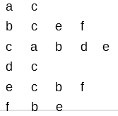
Calculating Parameters (CC value)
To calculate CC value of a node total number of edges among neighbors is divided by the possible number of edges in between the neighbors.
e.g. In this graph we find the CC value of node b
Select the total neighbors for node b.
i.e., c e f
Check all the possible edges that may exist in between the neighbors of node-b i.e., check does edge
c-e, c-f, e-c, e-f, f-c and f-e
exist and if exist count how many of them exist.

Slide 23
Calculating Parameters (CC value)
In this graph for node-b only c-e, e-c, e-f and f-e exis i.e., 4 edges.
Now divide this number by 2 as edge A-B is equal to edge B-A.
Total possible edges between neighbours is calculate using formula
total_possible_edges = n*(n-1) / 2
For node-b total possible edges is 3*(3-1)/2 which is equal to 3.
So CC value for node-b is 2/3 = 0.667 i.e.,
(total_edges_exist_among_neighbours / total_possible_edges_among_neighbours)

Slide 24

Calculating Parameters (Freeman’s Degree Centrality)
To calculate freeman’s degree centrality of a node-x total difference of degree of node with maximum degree to all of the neighboring nodes of node-x is divided by the total difference of degree of node-x to the degree of neighboring nodes.
i.e.

Slide 25

Calculating Parameters (Freeman’s Degree Centrality)
Node with maximum degree is node-c i.e., 4.
To find freeman’s degree centrality of node-b first select the neighbors of node b
i.e., c e f
Now to calculate the value of numerator (a) find sum of all the difference between degree of node-b and neighboring nodes of b i.e.,( c, e, f )

Slide 26
Calculating Parameters (Freeman’s Degree Centrality)
Degree of c, e and f are 4, 3 and 2 respectively.
So, a = |(3-4)| + |(3-3)| + |(3-2)| = 2
Similarly to calculate the value of denominator (b) find sum of all the difference between maximum degree of node in graph and neighboring nodes of b i.e.,( c, e, f )
As node-c have maximum degree i.e., 4
So b = |(4-4)| + |(4-3)| + |(4-2)| = 3
So freeman’s degree centrality of node-b is 2/3 = 0.667

Slide 27
Calculating Parameters (Enhanced Degree Centrality)
Enhanced degree centrality of a node is calculated by multiplying the CC value and freeman’s degree centrality of a node.
To find the enhanced degree centrality of node b in this graph first CC and freeman’s degree centrality is calculated and then multiplied
So, enhanced degree centrality of node b is :
0.667*0.667 = 0.447
CC value of node-b = 0.667
Freeman’s degree centrality of node-b = 0.667

Slide 28
Selection Procedure for Most Influential Node
We have calculated four parameters on the social network.
Based on each parameter ranking is done individually, in this way there are total four rankings obtained.
Now for each node their individual ranking in these four parameters is added.
The nodes with least aggregate rank is known as the most influential node.
e.g.
CC Value |  | Freeman’s Degree Centrality |  | Enhanced Degree Centrality
Node number | Rank | Node number | Rank | Node number | Rank
3 | 1 | 4 | 1 | 6 | 1
2 | 2 | 6 | 2 | 4 | 2
5 | 3 | 1 | 3 | 3 | 3
6 | 4 | 5 | 4 | 1 | 4
4 | 5 | 3 | 5 | 2 | 5
1 | 6 | 2 | 6 | 5 | 6

Slide 29
Selection Procedure for Most Influential Node
Aggregate sum of ranks :
If two or more nodes share the least ranking then all of them are the most influential node because their orientation, connectivity in the graph and connectivity among the neighbors is identical.
Total
Node number | Total Rank
1 | 14
2 | 16
3 | 15
4 | 12
5 | 18
6 | 9
Total (Sorted based on rank)
Node number | Total Rank
6 | 9
4 | 12
1 | 14
3 | 15
2 | 16
5 | 18

Slide 30
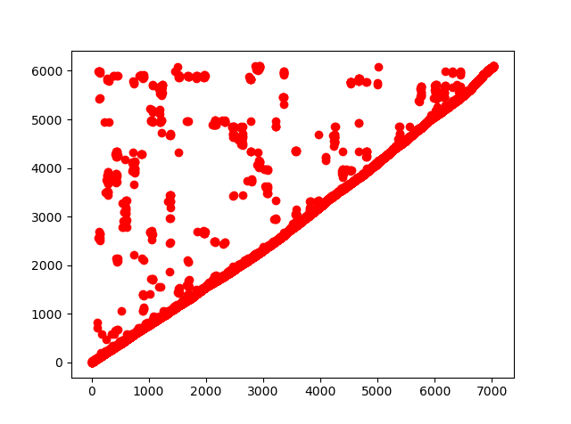
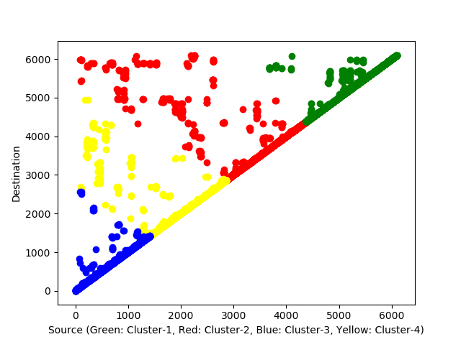
Experimental Result
Graphical visualization of clustering the road network.
Original Data
Clustered Data
Cluster centers :
[ 3328.32429559 3836.22647528]
[ 2000.1452164 2216.73861048]
[ 705.61107654 738.50777847]
[ 5181.33650084 5232.98882057]

Slide 31
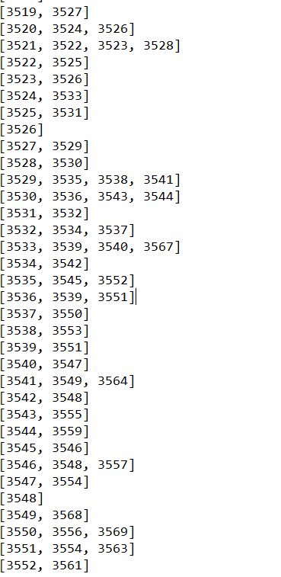
Experimental Result
Edge-list representation
of graph.

Slide 32
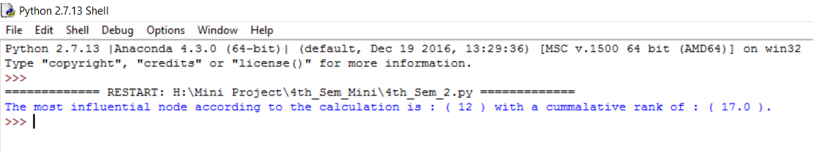
Experimental Result
Output obtained on total road network:
Plot in world-map :

Slide 33
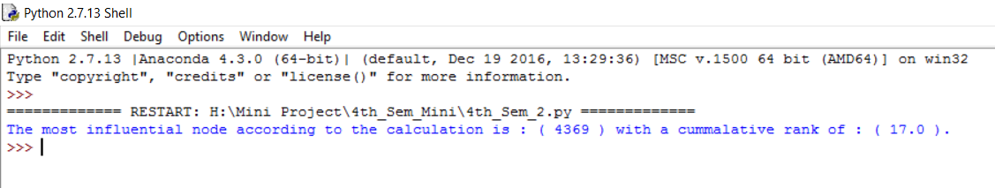
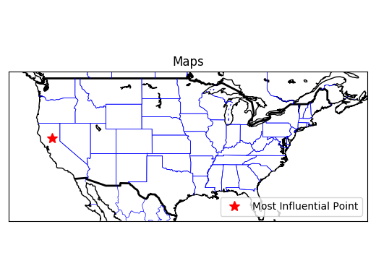
Experimental Result
Output obtained on Cluster-1:
Plot in world-map :

Slide 34
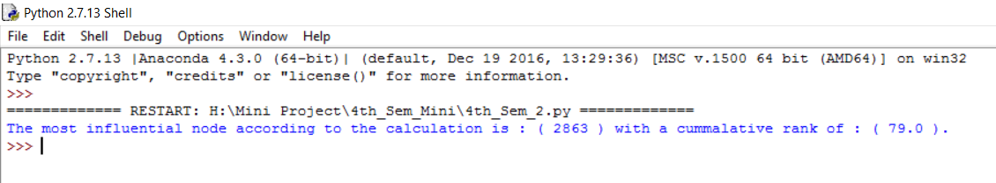
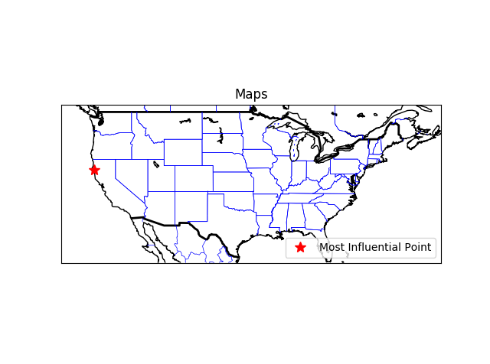
Experimental Result
Output obtained on Cluster-2:
Plot in world-map :

Slide 35
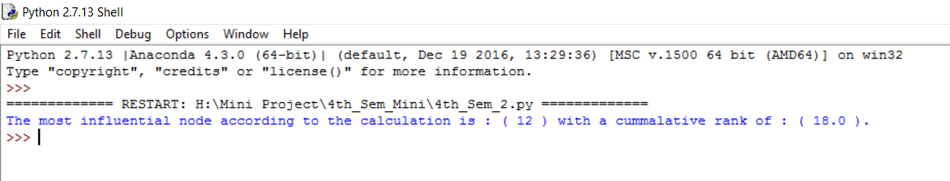
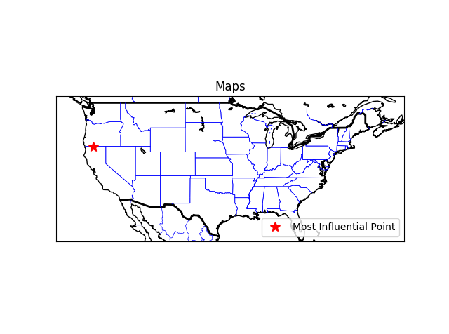
Experimental Result
Output obtained on Cluster-3:
Plot in world-map :

Slide 36
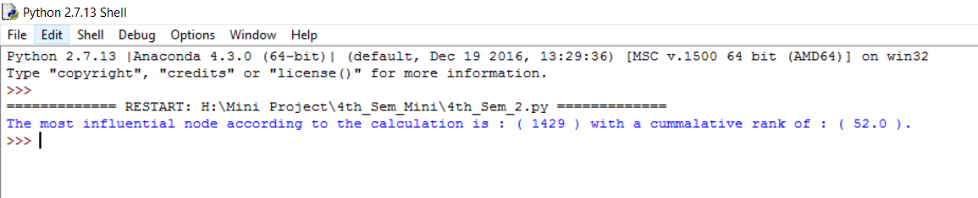

Experimental Result
Output obtained on Cluster-4:
Plot in world-map :

Slide 37
Experimental Result
Serial Number | Description | Latitude (Most-Influential node) | Longitude (Most-Influential node) | Degree Centrality | Clustering Coefficient | Enhanced Degree Centrality
1 | Total dataset | 41.907001 | -122.520287 | 0.0 | 0.0 | 0.0
2 | Cluster-1 | 39.500763 | -121.531273 | 0.0 | 0.0 | 0.0
3 | Cluster-2 | 40.351158 | -123.939072 | 0.0 | 0.0 | 0.0
4 | Cluster-3 | 41.907001 | -122.520287 | 0.0 | 0.0 | 0.0
5 | Cluster-4 | 41.15773 | -121.031357 | 0.0 | 0.0 | 0.0

Slide 38
Conclusion
Clustering is done because a state is huge in size.
To access a state from one point may lead to delay.
Knowledge of many influential points reduce the dependence of one point so work load can be divided.
The influential score i.e., total aggregate rank of all the points should be comparable to each other so that re-routing of traffic or work load can be easily done if most influential node goes out of order.

Slide 39
Statistics
Serial Number | Description | Nodes | Edges
1 | Total dataset | 6104 | 7033
2 | Cluster-1 | 1718 | 1808
3 | Cluster-2 | 1919 | 1877
4 | Cluster-3 | 1438 | 1604
5 | Cluster-4 | 1628 | 1744
Distribution of nodes and edges after using K-Mean clustering algorithm.

Slide 40
Statistics
Total number of nodes : 6,104
Total number of edges :7,033
Name of dataset : california.txt [5]
Source of dataset : https://www.cs.utah.edu/~lifeifei/SpatialDataset.htm

Slide 41
Software and Hard-ward Used
Programming Language : Python
Software Platform : Anaconda Python
Library used : ast, numpy, scipy, basemap, mathplotlib, pandas
Hardware : i7 processor, 8GB RAM

Slide 42
Links and References
[2] https://snap.stanford.edu/data/egonets-Facebook.html
Amedapu Srinivas, R. Leela Velusamy, “Identification of Influential Nodes from Social Networks based on Enhanced Degree Centrality Measure”, IEEE International Advance Computing Conference, 2015, pp. 1179-1184.
Agnieszka Rusinowska, Rudolf Berghammer, Harrie De Swart, Michel Grabisch, “Social networks: Prestige, centrality, and influence”. in: de Swart. (Ed.) RAMICS 2011, Springer, 2011, pp.22-39
Linton C. Freeman, “Centrality in Social Networks Conceptual Clarification”, Social Networks, vol. 1, Issue 3, 1978–1979, pp. 215-239.

Slide 43
Thank-You

Slide 44
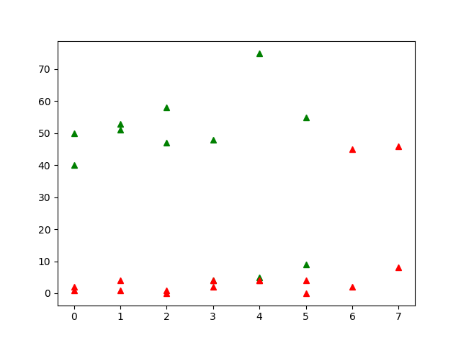
Example of K-Mean Clustering
Input graph :
(0,0)(0,1)(1,0)(1,1)(2,0)(2,1)(3,2)
(3,3)(4,5)(4,7)(5,0)(5,5)(5,11)(6,5)
(7,10)(0,40)(0,50)(1,50)(1,52)(2,55)
(2,59)(3,45)(4,75)(5,55)
Cluster -1 :
(0,0)(0,1)(1,0)(1,1)(2,0)(2,1)(3,2)(3,3)
(4,5)(5,0)(5,5) (6,5)(7,10)(6,40)(7,42)
Cluster -2 :
(4,7) (5,11) (0,40)(0,50)(1,50)(1,52)
(2,55)(2,59)(3,45)

